Slide 1

Compositional Reasoning of P programs
P Language
Ankush Desai
University Of California, Berkeley

Slide 2
Recap
P program is a collection of state machines.
P provides primitives for modeling non-determinism and performing “unit” testing.
P compiler generates both code for systematic testing and C/C++ code for execution.
P systematic testing engine is able to reproduce hard to find heisenbugs in asynchronous message passing programs.

Slide 3
Building Distributed Systems is Challenging
Multiple components (protocols) interacting.
Nondetermism: Failures, Asynchrony ..
Traditional exhaustive or random search techniques do not scale.
Inadequate test coverage.
In practice, bugs are generally found in production or after deployment !

Slide 4
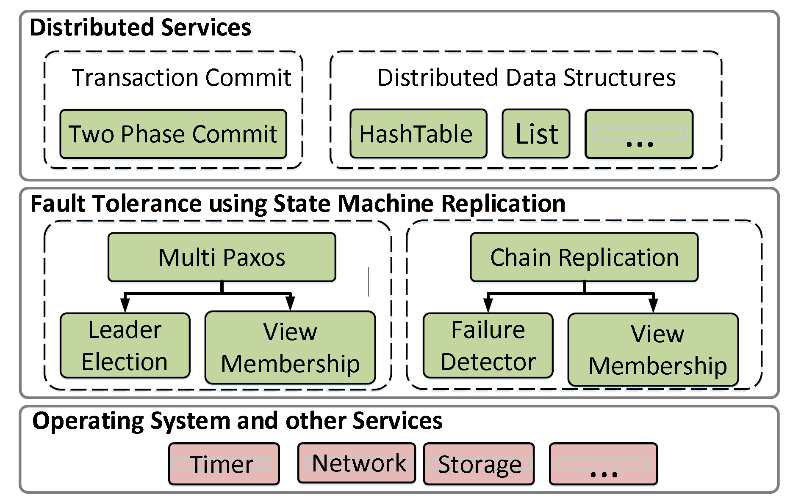
Fault Tolerant Distributed System
Software stack of a fault-tolerant distributed application
state machine replication is a general method for implementing a fault-tolerant service by replicating logs.

Slide 5
Fault Tolerant Distributed System
Observations:
Monolithic testing does not scale.
No component substitution and hence, no re-use of the systematic testing effort.

Slide 6
Fault Tolerant Distributed System
Solution:
Test-amplification via abstractions: Test each component in isolation.
Module system based on theory compositional refinement: Test “whole-system” properties from testing of each component in isolation.

Slide 7
Assume Guarantee (AG) Reasoning
Assume guarantee reasoning aims to decompose verification problems by divide and conquer using abstractions.
The unit of compositional reasoning in ModP is an open module.
Consider

Slide 8
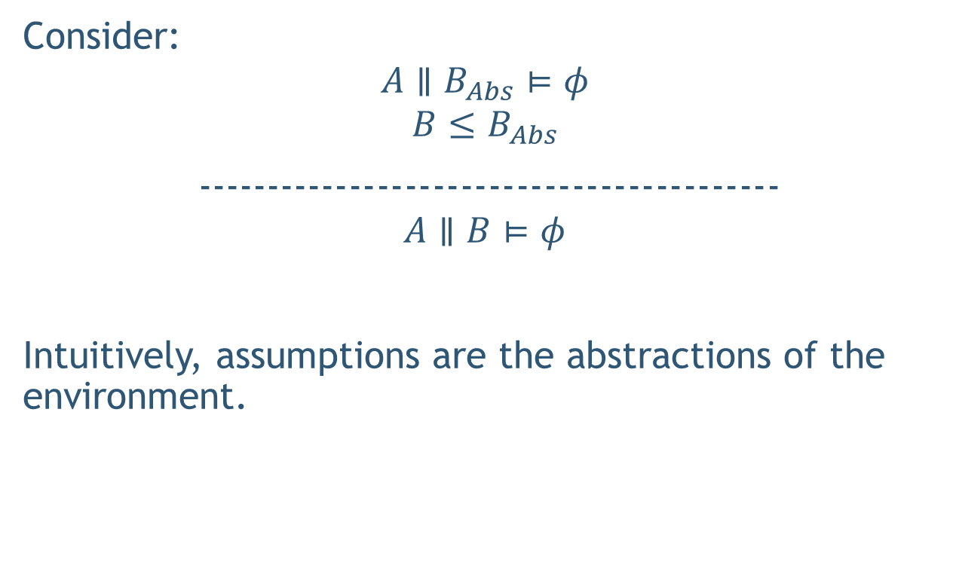
Assume Guarantee (AG) Reasoning
Consider:
$$A∥B_{Abs}⊨φ$$
$$B≤B_{Abs}$$
------------------------------------------
$$A∥B⊨φ$$
Intuitively, assumptions are the abstractions of the environment.

Slide 9






Compositional Reasoning of Distributed Systems
Decompose using AG principle into following simpler checks:

Slide 10
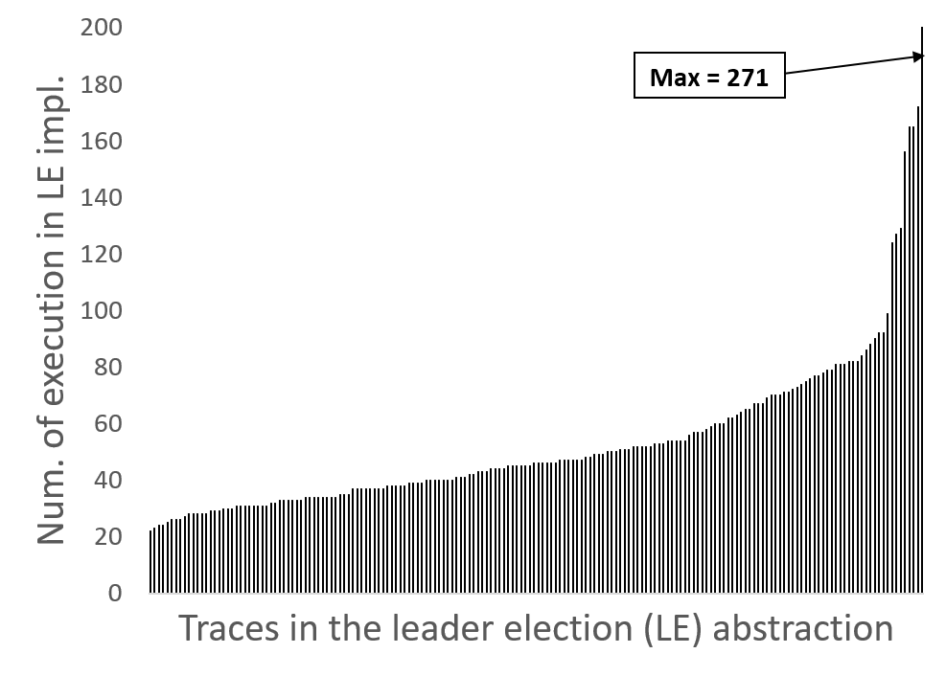
Test-Coverage Amplification

Slide 11
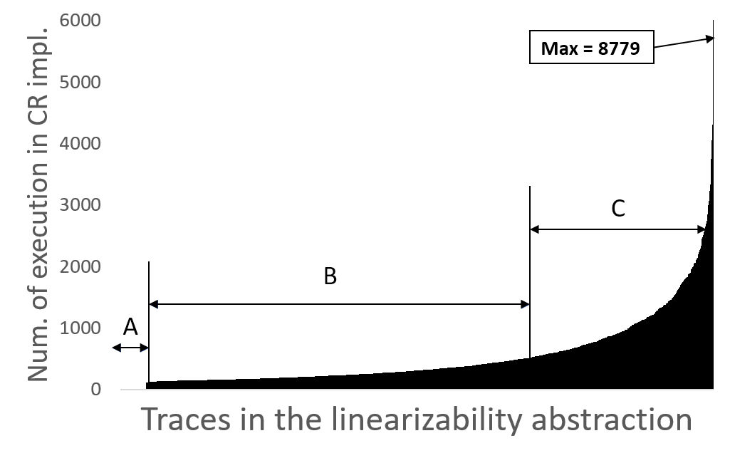
Test-Coverage Amplification

Slide 12
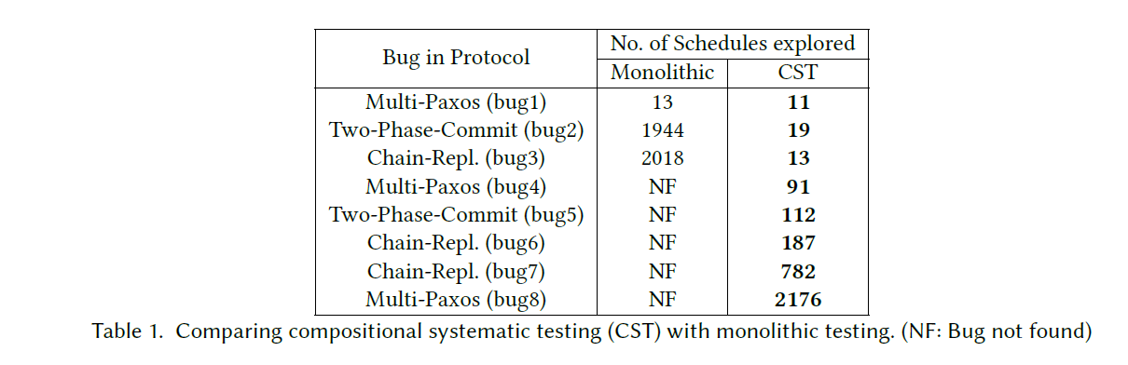
Compositional vs Monolithic

Slide 13
Module
A module in P is a collection of state machines.
module System = { ClientMachine, ServerMachine };

Slide 14
Module
A module in P is a collection of state machines.
module System = { ClientMachine, ServerMachine };

Slide 15
Module
A module in P is a collection of state machines.
module System = { ClientMachine, ServerMachine };

Slide 16
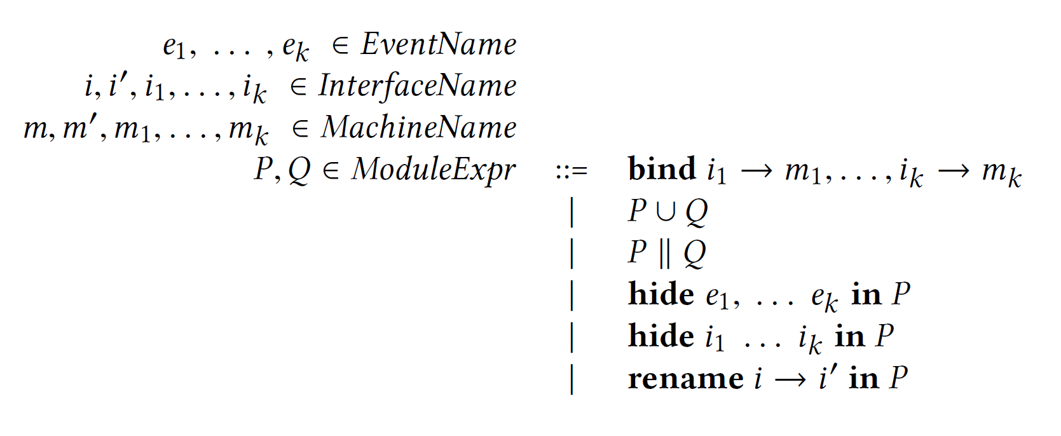
Module Contructors

Slide 17
Union

Slide 18
Compose

Slide 19
Substitution

Slide 20
Substitution

Slide 21
Example
Revisit PingPong

Slide 22
Example
Compositional Reasoning and Refinement Checking

Slide 23
Hierarchical Reasoning
https://github.com/p-org/P/blob/master/Src/Samples/FaultTolerantDistributedSystems/ChainReplication/Test/TestScript.p

Slide 24
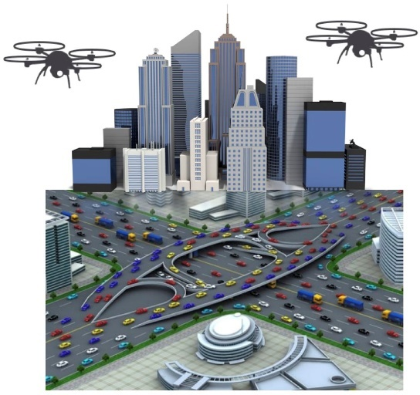
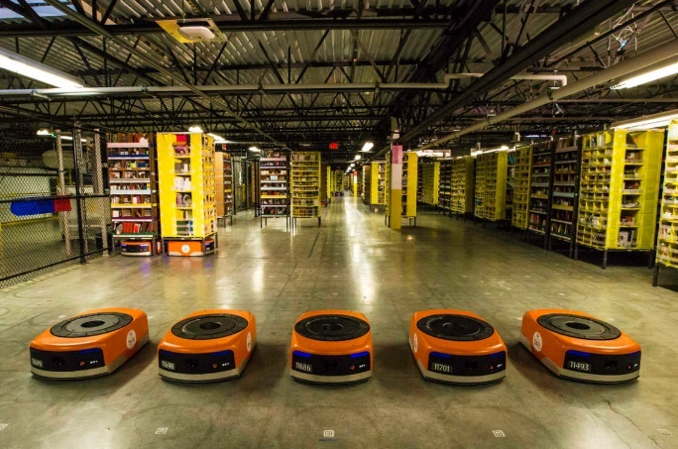
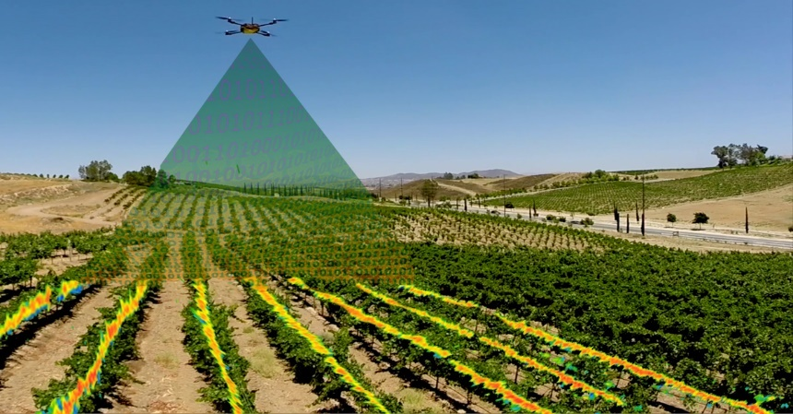
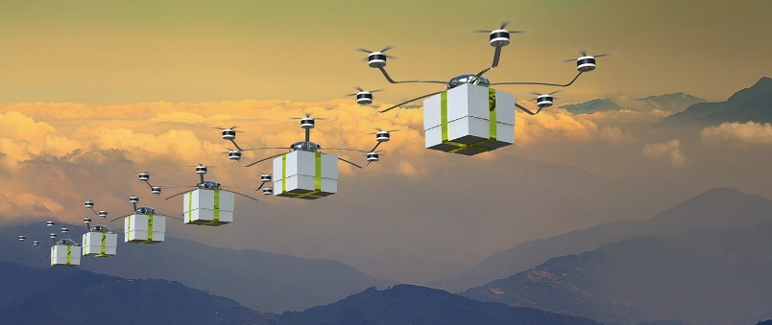
Autonomous Mobile Robotics
Warehouse
A major challenge in autonomous mobile robotics is programming robots with formal guarantees and high assurance of correct operation.
Surveillance
Delivery Systems
Agriculture
Notes:
Recent advances in autonomous robots collaborating to accomplish complex missions have been brought back exciting times for robotics research.
They have been applied to build real world systems and found applications in areas like

Slide 25
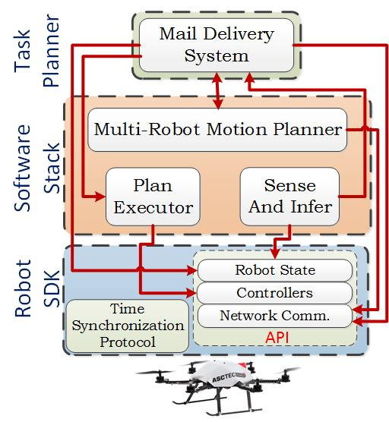
Robotic Software

Slide 26
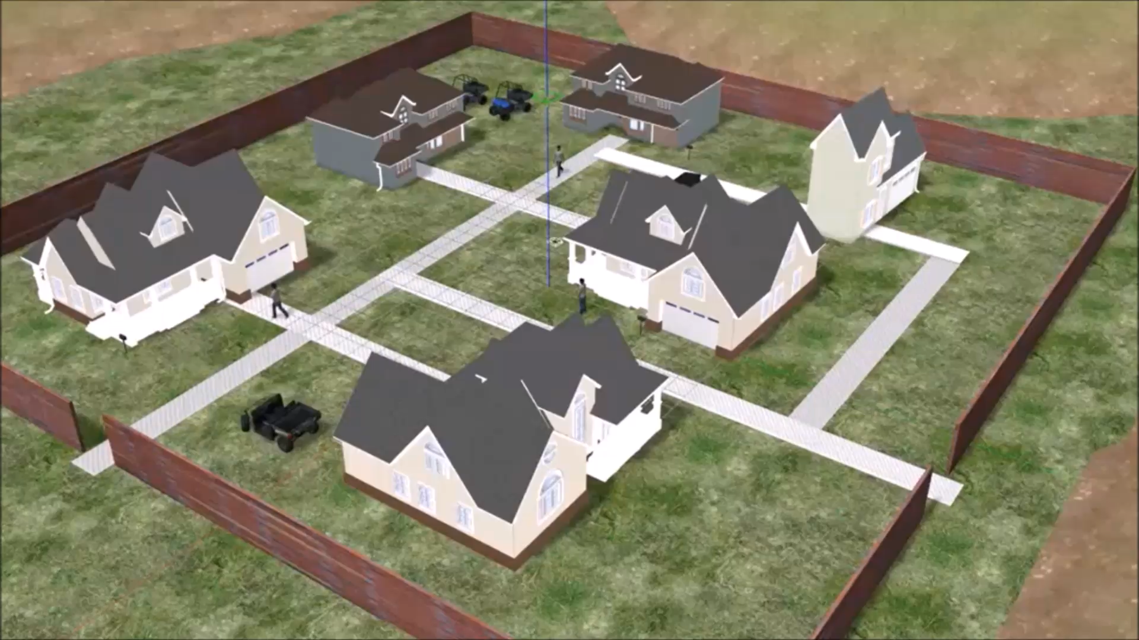
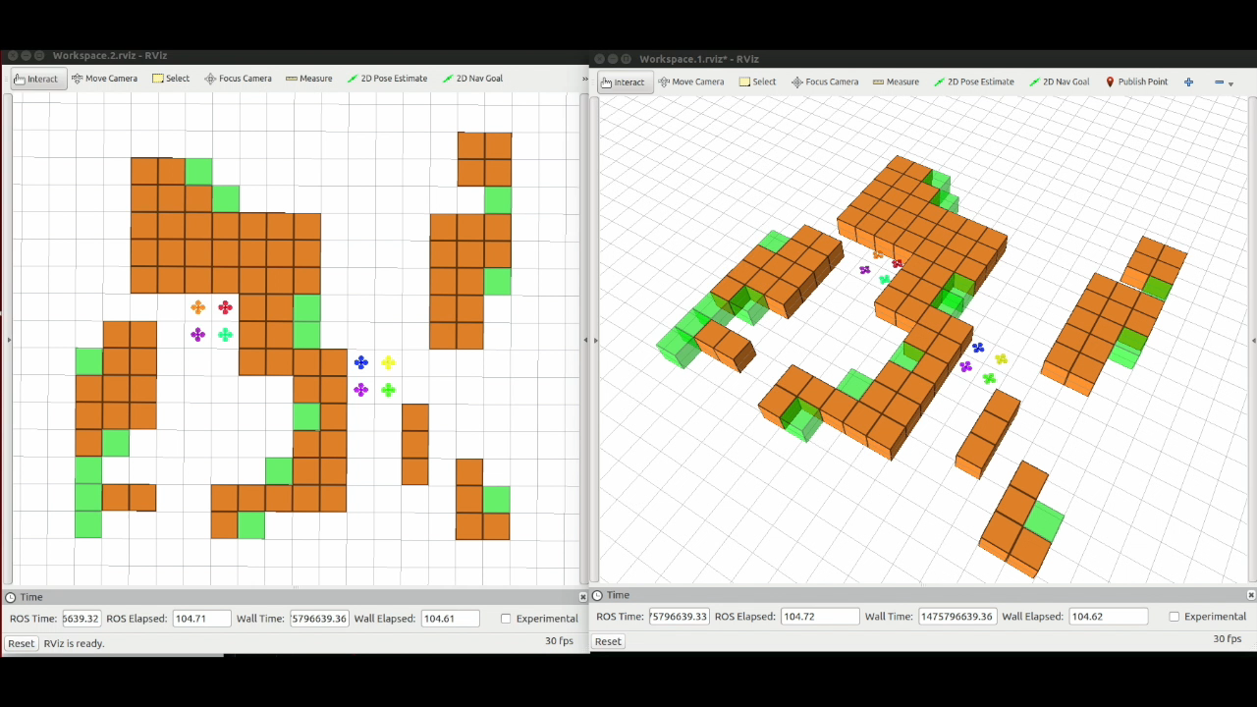
Demo Video

Slide 27
Thank You
DRONA is available on GitHub.
http://drona-org.github.io/Drona/

